Slide 1
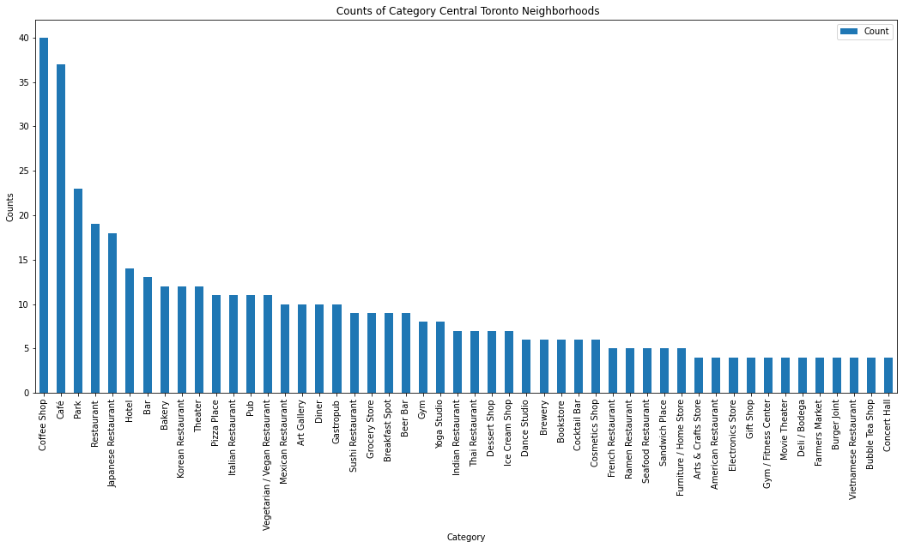
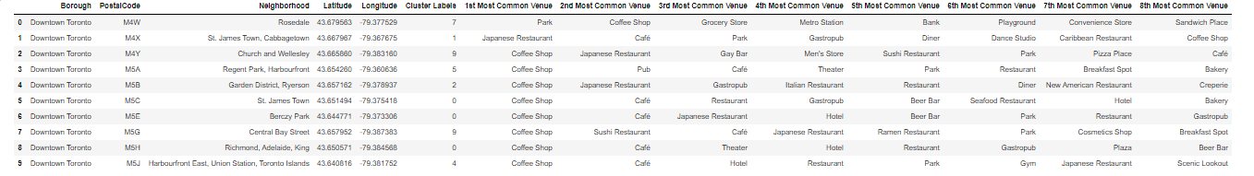
Finding the optimum neighborhood for drink/food business in Toronto central
Toronto is made of many neighborhood but the activity is concentrated in Downtown Borough.
The Borough has many venues . We are looking for a neighborhood where to open our business.
After using machine learning techniques (one hot encoding and clustering) we found the prime neighborhood would be Rosedale to open a café or restaurant. The second best would be Regent Park/ Harbourfront

